Slide 1
LINQ and Lambdas

Slide 2
Contents
Objectives
Learn about and use LINQ and Lambda expressions
Contents
The role of LINQ in .NET
Query syntax – Basic queries, Aggregation
Create and use Lambda expressions
Hands on Labs
Using LINQ and the supporting language features
Notes:
The industry has reached a stable point in the evolution of object-oriented (OO) technologies. We take for granted classes, objects, and methods. The next big challenge is to reduce the complexity of accessing and integrating information that is not natively defined using OO technology. The two most common sources being relational databases and XML.
The LINQ project, rather than adding relational or XML-specific features to the C# language and CLR, has taken a more general approach and has added general-purpose query facilities to the Framework that apply to all sources of information. It is called .NET Language-Integrated Query (LINQ).
The term language-integrated query indicates that query is an integrated feature of the C# programming language. Language-integrated query allows query expressions to benefit from the rich metadata, compile-time syntax checking, static typing and IntelliSense that was previously available only to more imperative code. Language-integrated query also allows a single general purpose declarative query facility to be applied to all in-memory information, not just information from external sources.
.NET Language-Integrated Query defines a set of general purpose standard query operators that allow traversal, filter, and projection operations to be expressed in a direct yet declarative way in any .NET-based programming language.

Slide 3
What is Language Integrated Query ?
Extend .NET languages to add native data querying capability
It has been compared to SQL language
SQL is an extremely rich language for databases
LINQ is infinitely extensible for any dataset
From a developer’s point of view
It is relatively easy to code
In one line it does what was traditionally done in 20!
Your code has to be minutely tested
Ok, let’s see a few examples and then look deeper into LINQ

Slide 4
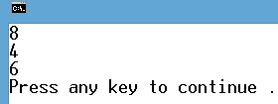
Simple query
int[] numbers = { 1, 9, 2, 8, 3, 7, 4, 6, 5 };
var query = from num in numbers
where num > 3 && num % 2 == 0
select num;
foreach (int n in query) {
Console.WriteLine(n);
}
Not using LINQ
int[] numbers = { 1,9,2,8,3,7,4,6,5 };
List<int> query = new List<int>();
foreach (int num in numbers) {
if (num > 3 && num % 2 == 0) query.Add(num); } // then a foreach to print ‘query’

Slide 5
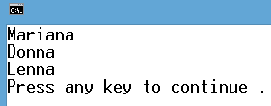
A more complex filter
List<string> names = new List<string> {
"Azzie", "Mariana", "Nancie", "Bob",
"Anna", "Freddie", "Donna", "Lenna", "David" };
var query = from name in names
where name.Length > 4 && name.EndsWith("na")
select name;
foreach (string n in query) {
Console.WriteLine(n);
}

Slide 6
What is the var keyword?
var tells the complier to infer the actual type
Does not equate to Object (C#) or Variant (VBA) type
Makes life of a developer a bit easier!
Compare these code samples:
Or
IEnumerable<T> is the base interface of collections that can be enumerated
i.e. you can use “foreach” on it
int[] numbers = { 1, 9, 2, 8, 3, 7, 4, 6, 5 };
IEnumerable<int> query = from num in numbers where num > 3 && num % 2 == 0 select num;
int[] numbers = { 1, 9, 2, 8, 3, 7, 4, 6, 5 };
var query = from num in numbers where num > 3 && num % 2 == 0 select num;

Slide 7
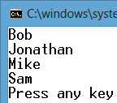
Ordering the result – orderby
List<Student> students = new List<Student> { new Student() {Age=18,Name="Sam"}, new Student() {Age=20,Name="Mike"}, new Student() {Age=19,Name="Bob"}, new Student() {Age=21,Name="Jonathan"} };
var query = from stu in students where stu.Age > 17 orderby stu.Name ascending select stu.Name;
foreach (string name in query) {
Console.WriteLine(name);
}

Slide 8
Returning selected attributes - using anonymous type
List<Student> students = new List<Student> {
new Student() { Age = 18, Name = "Sam", Subject = "C#" },
new Student() { Age = 20, Name = "Mike", Subject = "Java" },
new Student() { Age = 19, Name = "Bob", Subject = "Networking" },
new Student() { Age = 21, Name = "Jonathan", Subject = "Marketing" } };
var query = from stu in students where stu.Age > 18
select new { stu.Name, stu.Subject };
foreach (var stu in query) {
Console.WriteLine($"Name:{stu.Name}, Subject:{stu.Subject}");
}
Notes:
There are occasions when you wish to return more than one property of an object but not the entire object.
The slide example shows a typical usage of an anonymous object in a LINQ expression. Usually when you create an object using the "new" keyword, you would mention the name of a class. Please note the absence of a type name after the "new" keyword which is why the object returned is an anonymous type known only to the compiler…but when you iterate over ‘query’ in the foreach loop each instance of ‘stu’ is referencing an instance of that anonymous type whose compiler generated properties are ‘Name’ and ‘Subject’. Clearly ‘var’ has to be used as the datatype of ‘stu’ as the developer does not know that actual type of the anonymous object(s).

Slide 9
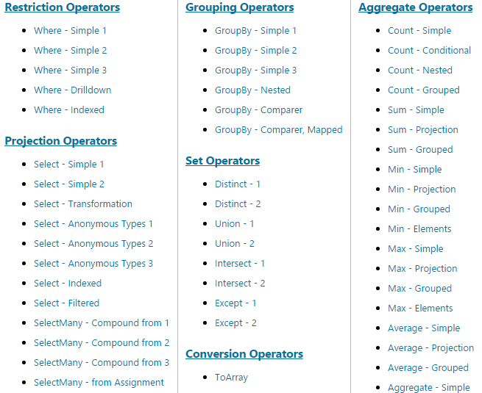
Need to learn more?
Google “101 Linq Samples” for all the LINQ examples

Slide 10
Let’s use a couple of those keywords
List<string> names = new List<string> {
"Azzie", "Mariana", "Nancie", "Bob", "Anna", "Freddie", "Donna", "Lenna", "David","Azzie", "Mariana", "Nancie", "Bob",
};
var query = from name in names where name.Length > 4 select name;
Console.WriteLine( query.Distinct().Count() );
int[] numbers = { 1, 22, 2, 88, 55, 44, 33, 99, 22, 55 };
Console.WriteLine( numbers.Distinct().Average() );

Slide 11
Lambda Expressions

Slide 12
Using a Func<> - Part 1/2
Slightly shorter way
The method asks for a function name that returns a bool and has a parameter of type int.
int[] numbers = { 1, 1, 2, 3, 5, 8, 13, 21, 34 };
var result = numbers.Where()
Notes:
The “from name in names where name.Length > 4 select name” syntax is LINQ - language integrated query, but it is just syntax, ‘syntactic sugar’.
When LINQ was introduced into C# 3 (2007 approx) the language spec changed, the compiler needed changing, there were more ‘libraries’ of classes & methods supplied in .NET 3.5 released simultaneously with C#3. But there was no new version of the CLR – it stayed on CLR 2.0, so basically the .NET runtime knows nothing of LINQ, it is a language feature that is compiled into method calls.
So “var query = from n in names where n.Length > 4 select n.ToUpper()” compiles into something along the lines of
var query = names.Where(….).Select(…)
But what do these Where/Select methods take as parameters – answer delegate references. These delegate references are all some variation of the generic Func<..,..> delegate type. ANYWHERE you need to supply a delegate reference you can ALWAYS supply a suitable (correct signature) method.
You are going to see in the following section where and how these methods can be written.
In a ‘normal’ location with a full name and signature or ‘anonymously’ ‘on the fly and in situ’
Read on

Slide 13
Using a Func<> - Part 2/2
Lets create the function
int[] numbers = { 1, 1, 2, 3, 5, 8, 13, 21, 34 };
var query = numbers.Where(IsOdd);
static bool IsOdd(int n) {
return (n % 2 == 1); }
The system will call IsOdd() passing each int in numbers and only returns those which are odd (return is true)
Notes:
IsOdd(..) has the correct signature to produce a Func<int,bool> delegate which is what must be passed to the Where method when it is used on an IEnumerable<int> collection (which is what ‘numbers’ is).

Slide 14

Lambda – Towards a more compact code
Even simpler, use a lambda expression
int[] numbers = { 1, 1, 2, 3, 5, 8, 13, 21, 34 };
var query= numbers.Where(n => n % 2 == 1);
static bool IsOdd(int n) {
return (n % 2 == 1);
}
The system will pass each int in numbers into the (n % 2 == 1) code and only returns those which return true
Not needed
Let’s learn by example
Notes:
Now the method is written on the fly ‘in situ’, its parameter is ‘n’ and it is implicitly an int the bool it returns is the result of ‘n % 2 == 1’.
You have still produced a Func<int,bool> delegate but via an anonymous (name known only to the compiler that generates it under the covers) method authored via a lambda expression.

Slide 15
Simple query the Lambda way
int[] numbers = { 1, 9, 2, 8, 3, 7, 4, 6, 5 };
var query = from num in numbers where num > 3 && num % 2 == 0 select num;
foreach (int n in query) {
Console.WriteLine(n);
}
var query = numbers.Where(num => num > 3 && num % 2 == 0); // then the foreach loop to display them

Slide 16
A more complex filter
List<string> names = new List<string> {
"Azzie", "Mariana", "Nancie", "Bob",
"Anna", "Freddie", "Donna", "Lenna", "David" };
var query = from name in names
where name.Length > 4 && name.EndsWith("na")
select name;
foreach (string n in query) {
Console.WriteLine(n);
}
var query = names.Where(name=> name.Length > 4 && name.EndsWith("na"));

Slide 17
Ordering the result – orderby
List<Student> students = new List<Student> { new Student() {Age=18,Name="Sam"}, new Student() {Age=20,Name="Mike"}, new Student() {Age=19,Name="Bob"}, new Student(){Age=21,Name="Jonathan"} };
var query = from stu in students
where stu.Age > 17
orderby stu.Name ascending
select stu.Name;
foreach (string name in query) {
Console.WriteLine(name);
}
var query =
students.Where(stu => stu.Age > 17).OrderBy(stu => stu.Name);
Notes:
The OrderBy method takes a Func<TSource, TKey>.
TSource is the type of the source collection – so Student in this case
TKey is what part of that source is being used as a sort key for each (Student) – the Name in this case
So the 2nd lambda produces a Func<Student,string> delegate
Basically from each Student (the datatype of ‘stu’) extract the Name to be used for an ascending sort.

Slide 18
LINQ – Aggregation Operators
General purpose Count operator (useful with Grouping)
4 common numerical aggregation methods
Sum, Min, Max, Average
int[] numbers = { 3, 5, 7, 9 };
string[] names = {"Paul", "Steve", "Peter", "Laurence"};
int totalOfNumbers = numbers.Sum();
int totalLengthOfNames = names.Sum(s => s.Length);
Notes:
These sorts of methods are exactly that, methods, and are only available as method calls using dot notation.
They are immediately executed.
There are for example 20 overloads of Sum.
One for each of int, long, decimal, double, float
Plus one for each of their nullable versions. i.e Sum(IEnumerable<int?> source)
For these 10 different datatypes there is one version that does not require a Func<,> and one that does.
In the 1st example above we are invoking .Sum() which simply sums all the elements of the underlying int[] source
In the 2nd example we are supplying a Func delegate via a lambda expression to project the string into a (numeric) int so that it can be Sum’med.

Slide 19
List<> FindAll method
See if you can figure out what these statements do:
List<int> numbers = new List<int>{ 1, 1, 2, 3, 5, 8};
List<int> oddOnes = numbers.FindAll(n => n % 2 == 1);
double avg1 = numbers.FindAll(n => n % 2 == 1).Average();
double avg2 =
numbers.FindAll(n => n % 2 == 1).Distinct().Average();

Slide 20
Returning selected attributes - using anonymous type
List<Student> students = new List<Student> {
new Student() { Age = 18, Name = "Sam", Subject = "C#" },
new Student() { Age = 20, Name = "Mike", Subject = "Java" },
new Student() { Age = 19, Name = "Bob", Subject = "Networking" },
new Student() { Age = 21, Name = "Jonathan", Subject = "Marketing" }
};
var query = students.Select( stu => new { stu.Name, stu.Subject });
foreach (var stu in query) {
Console.WriteLine($"Name:{stu.Name}, Subject:{stu.Subject}"); }
Notes:
There are occasions when you wish to return more than one property of an object instead of returning the entire object.
The slide example shows a typical usage of an anonymous object in a Lambda expression. Usually when you create an object using the "new" keyword, you would mention the name of a class. Please note the absence of a type name after the "new" keyword which is why the object returned is of a type known only to the compiler and hence ‘var’ has to be used to refer to an instance of it in the foreach that follows.

Slide 21
Review
In this chapter you learned how to use Lambda operations

Slide 22
Lab – LINQ and Lambda
Please see your Lab Guide
Lambda

